Slide 1
Power Rule

Slide 2

Power Rule
If $f\left(x\right)=x^{n}$, then $f^{′}\left(x\right)=nx^{n−1}$

Slide 3
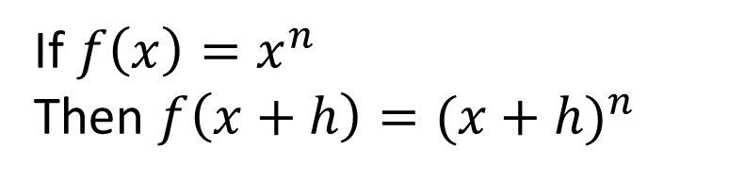

If $f\left(x\right)=x^{n}$, then $f^{′}\left(x\right)=nx^{n−1}$
Proof:
$f^{′}\left(x\right)=\begin{matrix}lim⁡ \\ h→0\end{matrix} \frac{f\left(x+h\right)−f(x)}{h}$
If $f\left(x\right)=x^{n}$
Then $f\left(x+h\right)={(x+h)}^{n}$

Slide 4
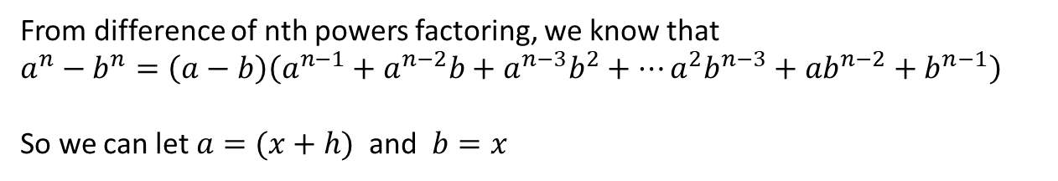

If $f\left(x\right)=x^{n}$, then $f^{′}\left(x\right)=nx^{n−1}$
Proof:
$f^{′}\left(x\right)=\begin{matrix}lim⁡ \\ h→0\end{matrix} \frac{f\left(x+h\right)−f(x)}{h}$
$=\begin{matrix}lim⁡ \\ h→0\end{matrix} \frac{{(x+h)}^{n}−x^{n}}{h}$
From difference of nth powers factoring, we know that
$a^{n}−b^{n}=\left(a−b\right)\left(a^{n−1}+a^{n−2}b+a^{n−3}b^{2}+…a^{2}b^{n−3}+{ab}^{n−2}+b^{n−1}\right)$
So we can let $a=(x+h)$ and $b=x$

Slide 5
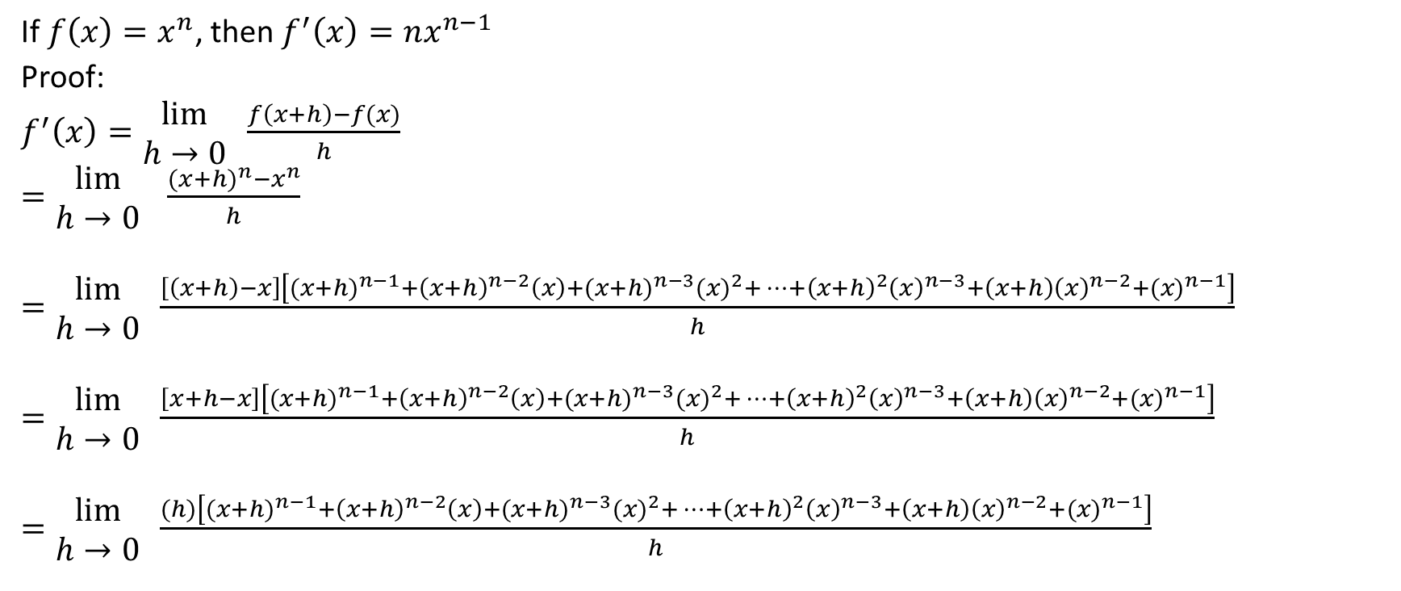
If $f\left(x\right)=x^{n}$, then $f^{′}\left(x\right)=nx^{n−1}$
Proof:
$f^{′}\left(x\right)=\begin{matrix}lim⁡ \\ h→0\end{matrix} \frac{f\left(x+h\right)−f(x)}{h}$
$=\begin{matrix}lim⁡ \\ h→0\end{matrix} \frac{{(x+h)}^{n}−x^{n}}{h}$
$=\begin{matrix}lim⁡ \\ h→0\end{matrix} \frac{\left[\left(x+h\right)−x\right]\left[{(x+h)}^{n−1}+{\left(x+h\right)}^{n−2}\left(x\right)+{(x+h)}^{n−3}{(x)}^{2}+…+{\left(x+h\right)}^{2}{\left(x\right)}^{n−3}+{\left(x+h\right)\left(x\right)}^{n−2}+{(x)}^{n−1}\right]}{h}$
$=\begin{matrix}lim⁡ \\ h→0\end{matrix} \frac{\left[x+h−x\right]\left[{(x+h)}^{n−1}+{\left(x+h\right)}^{n−2}\left(x\right)+{(x+h)}^{n−3}{(x)}^{2}+…+{\left(x+h\right)}^{2}{\left(x\right)}^{n−3}+{\left(x+h\right)\left(x\right)}^{n−2}+{(x)}^{n−1}\right]}{h}$
$=\begin{matrix}lim⁡ \\ h→0\end{matrix} \frac{(h)\left[{(x+h)}^{n−1}+{\left(x+h\right)}^{n−2}\left(x\right)+{(x+h)}^{n−3}{(x)}^{2}+…+{\left(x+h\right)}^{2}{\left(x\right)}^{n−3}+{\left(x+h\right)\left(x\right)}^{n−2}+{(x)}^{n−1}\right]}{h}$

Slide 6

If $f\left(x\right)=x^{n}$, then $f^{′}\left(x\right)=nx^{n−1}$
Proof:
$f^{′}\left(x\right)=\begin{matrix}lim⁡ \\ h→0\end{matrix} \frac{(h)\left[{(x+h)}^{n−1}+{\left(x+h\right)}^{n−2}\left(x\right)+{(x+h)}^{n−3}{(x)}^{2}+…+{\left(x+h\right)}^{2}{\left(x\right)}^{n−3}+{\left(x+h\right)\left(x\right)}^{n−2}+{(x)}^{n−1}\right]}{h}$
Now, we can cancel out like factors in the numerator and the denominator

Slide 7
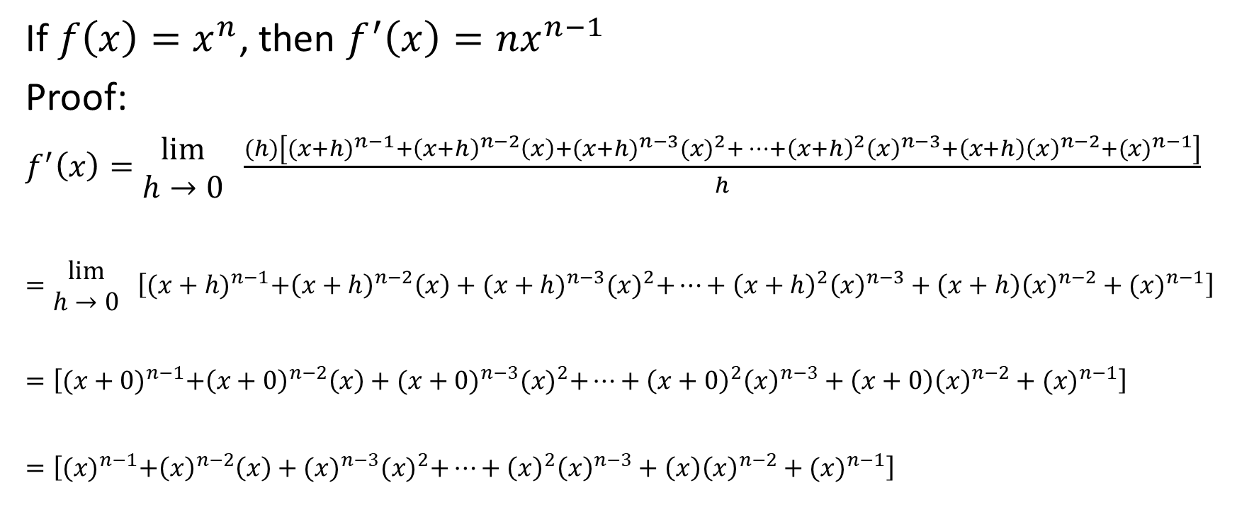
If $f\left(x\right)=x^{n}$, then $f^{′}\left(x\right)=nx^{n−1}$
Proof:
$f^{′}\left(x\right)=\begin{matrix}lim⁡ \\ h→0\end{matrix} \frac{(h)\left[{(x+h)}^{n−1}+{\left(x+h\right)}^{n−2}\left(x\right)+{(x+h)}^{n−3}{(x)}^{2}+…+{\left(x+h\right)}^{2}{\left(x\right)}^{n−3}+{\left(x+h\right)\left(x\right)}^{n−2}+{(x)}^{n−1}\right]}{h}$
$=\begin{matrix}lim⁡ \\ h→0\end{matrix} \left[{(x+h)}^{n−1}+{\left(x+h\right)}^{n−2}\left(x\right)+{(x+h)}^{n−3}{(x)}^{2}+…+{\left(x+h\right)}^{2}{\left(x\right)}^{n−3}+\left(x+h\right){\left(x\right)}^{n−2}+{(x)}^{n−1}\right]$
$=\left[{(x+0)}^{n−1}+{\left(x+0\right)}^{n−2}\left(x\right)+{(x+0)}^{n−3}{(x)}^{2}+…+{\left(x+0\right)}^{2}{\left(x\right)}^{n−3}+\left(x+0\right){\left(x\right)}^{n−2}+{(x)}^{n−1}\right]$
$=\left[{(x)}^{n−1}+{\left(x\right)}^{n−2}\left(x\right)+{(x)}^{n−3}{(x)}^{2}+…+{\left(x\right)}^{2}{\left(x\right)}^{n−3}+\left(x\right){\left(x\right)}^{n−2}+{(x)}^{n−1}\right]$

Slide 8

If $f\left(x\right)=x^{n}$, then $f^{′}\left(x\right)=nx^{n−1}$
Proof:
$=\left[{(x)}^{n−1}+{\left(x\right)}^{n−1}+{(x)}^{n−1}+…+{\left(x\right)}^{n−1}+{\left(x\right)}^{n−1}+{(x)}^{n−1}\right]$

Slide 9

If $f\left(x\right)=x^{n}$, then $f^{′}\left(x\right)=nx^{n−1}$
Proof:
$=\left[{(x)}^{n−1}+{\left(x\right)}^{n−1}+{(x)}^{n−1}+…+{\left(x\right)}^{n−1}+{\left(x\right)}^{n−1}+{(x)}^{n−1}\right]$
Each term ends up equaling $x^{n−1}$

Slide 10
If $f\left(x\right)=x^{n}$, then $f^{′}\left(x\right)=nx^{n−1}$
Proof:
$=\left[{(x)}^{n−1}+{\left(x\right)}^{n−1}+{(x)}^{n−1}+…+{\left(x\right)}^{n−1}+{\left(x\right)}^{n−1}+{(x)}^{n−1}\right]$
Each term ends up equaling $x^{n−1}$
The question is how many such terms there are. To answer, this, we can refer back to our original discussion of the difference of nth powers factoring.

Slide 11
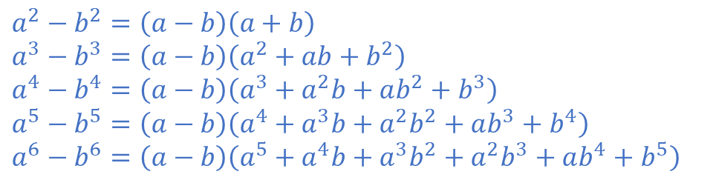
If $f\left(x\right)=x^{n}$, then $f^{′}\left(x\right)=nx^{n−1}$
Proof:
$=\left[{(x)}^{n−1}+{\left(x\right)}^{n−1}+{(x)}^{n−1}+…+{\left(x\right)}^{n−1}+{\left(x\right)}^{n−1}+{(x)}^{n−1}\right]$
Some examples of difference of nth power factoring are shown below
$a^{2}−b^{2}=\left(a−b\right)\left(a+b\right)$
$a^{3}−b^{3}=\left(a−b\right)\left(a^{2}+ab+b^{2}\right)$
$a^{4}−b^{4}=\left(a−b\right)\left(a^{3}+a^{2}b+ab^{2}+b^{3}\right)$
$a^{5}−b^{5}=\left(a−b\right)\left(a^{4}+a^{3}b+a^{2}b^{2}+ab^{3}+b^{4}\right)$
$a^{6}−b^{6}=\left(a−b\right)\left(a^{5}+a^{4}b+a^{3}b^{2}+a^{2}b^{3}+ab^{4}+b^{5}\right)$

Slide 12

In each case, the first bracket is (a-b). In our proof, this simplified to h and was crossed out in the denominator.
The second bracket always contains n terms.
For example, when factoring $a^{2}−b^{2}$, the second bracket has two terms. Similarly, , when factoring $a^{3}−b^{3}$, the second bracket has three terms.
By extension, when factoring $a^{n}−b^{n}$, the second bracket has n terms.
If $f\left(x\right)=x^{n}$, then $f^{′}\left(x\right)=nx^{n−1}$
Proof:
$=\left[{(x)}^{n−1}+{\left(x\right)}^{n−1}+{(x)}^{n−1}+…+{\left(x\right)}^{n−1}+{\left(x\right)}^{n−1}+{(x)}^{n−1}\right]$
$a^{2}−b^{2}=\left(a−b\right)\left(a+b\right)$
$a^{3}−b^{3}=\left(a−b\right)\left(a^{2}+ab+b^{2}\right)$
$a^{4}−b^{4}=\left(a−b\right)\left(a^{3}+a^{2}b+ab^{2}+b^{3}\right)$
$a^{5}−b^{5}=\left(a−b\right)\left(a^{4}+a^{3}b+a^{2}b^{2}+ab^{3}+b^{4}\right)$
$a^{6}−b^{6}=\left(a−b\right)\left(a^{5}+a^{4}b+a^{3}b^{2}+a^{2}b^{3}+ab^{4}+b^{5}\right)$

Slide 13
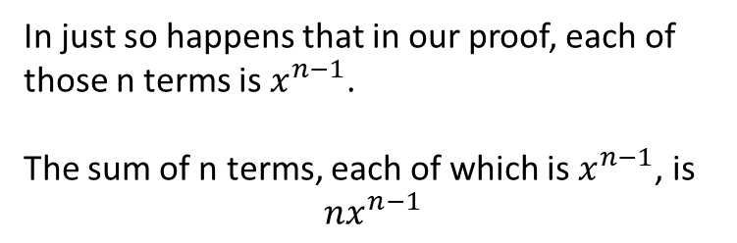
If $f\left(x\right)=x^{n}$, then $f^{′}\left(x\right)=nx^{n−1}$
Proof:
$=\left[{(x)}^{n−1}+{\left(x\right)}^{n−1}+{(x)}^{n−1}+…+{\left(x\right)}^{n−1}+{\left(x\right)}^{n−1}+{(x)}^{n−1}\right]$
In just so happens that in our proof, each of those n terms is $x^{n−1}$.
The sum of n terms, each of which is $x^{n−1}$, is
$$nx^{n−1}$$

Slide 14

If $f\left(x\right)=x^{n}$, then $f^{′}\left(x\right)=nx^{n−1}$
Proof:
$=\left[{(x)}^{n−1}+{\left(x\right)}^{n−1}+{(x)}^{n−1}+…+{\left(x\right)}^{n−1}+{\left(x\right)}^{n−1}+{(x)}^{n−1}\right]$
$=nx^{n−1}$
Therefore, if $f\left(x\right)=x^{n}$, then $f^{′}\left(x\right)=nx^{n−1}$

Slide 15

Example
If $f\left(x\right)={4x}^{5}$, then determine $f^{′}\left(x\right)$

Slide 16




If $f\left(x\right)={4x}^{5}$, then determine $f^{′}\left(x\right)$
Solution:
$4x^{5} → \left(5\right)\left(4\right)x^{5−1} → 20x^{4}$
$f^{′}\left(x\right)=20x^{4}$

Slide 17

Example
If $f\left(x\right)={11x}^{\frac{5}{2}}$, then determine $f^{′}\left(x\right)$

Slide 18
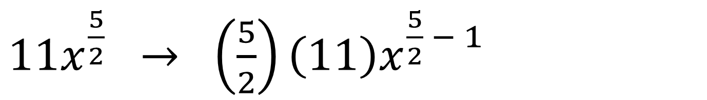



If $f\left(x\right)={11x}^{\frac{5}{2}}$, then determine $f^{′}\left(x\right)$
Solution:
$11x^{\frac{5}{2}} → \left(\frac{5}{2}\right)\left(11\right)x^{\frac{5}{2} − 1}$

Slide 19
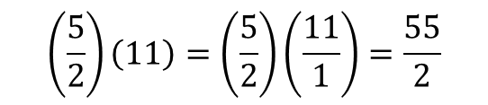
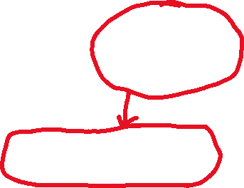
If $f\left(x\right)={11x}^{\frac{5}{2}}$, then determine $f^{′}\left(x\right)$
Solution:
$11x^{\frac{5}{2}} → \left(\frac{5}{2}\right)\left(11\right)x^{\frac{5}{2} − 1}$
$$\left(\frac{5}{2}\right)\left(11\right)=\left(\frac{5}{2}\right)\left(\frac{11}{1}\right)=\frac{55}{2}$$

Slide 20



If $f\left(x\right)={11x}^{\frac{5}{2}}$, then determine $f^{′}\left(x\right)$
Solution:
$11x^{\frac{5}{2}} → \left(\frac{5}{2}\right)\left(11\right)x^{\frac{5}{2} − 1}$
$\frac{5}{2}−1=\frac{5}{2} − \frac{2}{2}=\frac{3}{2}$

Slide 21
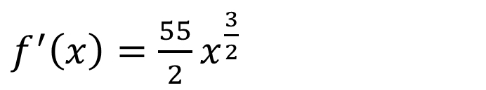
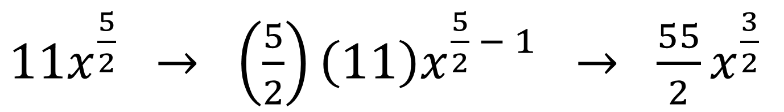
If $f\left(x\right)={11x}^{\frac{5}{2}}$, then determine $f^{′}\left(x\right)$
Solution:
$11x^{\frac{5}{2}} → \left(\frac{5}{2}\right)\left(11\right)x^{\frac{5}{2} − 1} → \frac{55}{2}x^{\frac{3}{2}}$
$f^{′}\left(x\right)=\frac{55}{2}x^{\frac{3}{2}}$

Slide 22

Example
If $f\left(x\right)=7$, then determine $f^{′}\left(x\right)$

Slide 23


If $f\left(x\right)=7$, then determine $f^{′}\left(x\right)$
Solution:
$x^{0}=1$
Therefore, $7=7x^{0}$
$7x^{0} → \left(0\right)\left(7\right)x^{0−1} → 0x^{−1} → 0$
By extension, the derivative of any constant term is 0

Slide 24

If $f\left(x\right)=7$, then determine $f^{′}\left(x\right)$
Solution:
If $f\left(x\right)=7$, then $f^{′}\left(x\right)=0$

Slide 25

Example
Determine $g′(x)$ if $g\left(x\right)=4x^{3}−3\sqrt{x}$

Slide 26

Determine $g′(x)$ if $g\left(x\right)=4x^{3}−3\sqrt{x}$
Solution:
$g\left(x\right)=4x^{3}−3x^{\frac{1}{2}}$
$g^{′}\left(x\right)=12x^{2}−\frac{3}{2}x^{\frac{−1}{2}}$

Slide 27

Example
Determine $k′(x)$ if $k\left(x\right)={(5x−3)}^{2}$

Slide 28
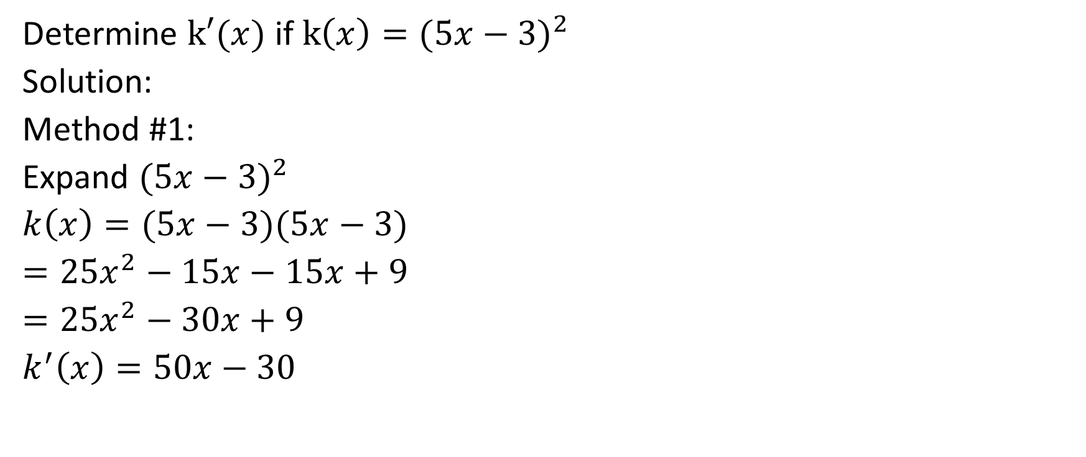
Determine $k′(x)$ if $k\left(x\right)={(5x−3)}^{2}$
Solution:
Method #1:
Expand ${(5x−3)}^{2}$
$k\left(x\right)=(5x−3)(5x−3)$
$=25x^{2}−15x−15x+9$
$=25x^{2}−30x+9$
$k^{′}\left(x\right)=50x−30$

Slide 29

Determine $k′(x)$ if $k\left(x\right)={(5x−3)}^{2}$
Solution:
Method #2:
Use the power of a function rule, which is a form of the chain rule.

Slide 30
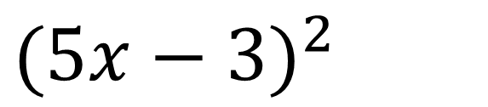


Determine $k′(x)$ if $k\left(x\right)={(5x−3)}^{2}$
Solution:
Method #2:
Use the power of a function rule, which is a form of the chain rule.
${(5x−3)}^{2}$
Step 1: Multiply the exponent on the outside of the bracket by the coefficient in front of the bracket. In this case, that coefficient is 1. Then, subtract 1 from the exponent.

Slide 31
Determine $k′(x)$ if $k\left(x\right)={(5x−3)}^{2}$
Solution:
Method #2:
Use the power of a function rule, which is a form of the chain rule.
${(5x−3)}^{2} →2(5x−3)$

Slide 32
Determine $k′(x)$ if $k\left(x\right)={(5x−3)}^{2}$
Solution:
Method #2:
Use the power of a function rule, which is a form of the chain rule.
${(5x−3)}^{2} →2\left(5x−3\right)$
Step 2: Multiply by the derivative of expression in the bracket

Slide 33
Determine $k′(x)$ if $k\left(x\right)={(5x−3)}^{2}$
Solution:
Method #2:
Use the power of a function rule, which is a form of the chain rule.
${(5x−3)}^{2} →2\left(5x−3\right)→2(5x−3)(5)$

Slide 34
Determine $k′(x)$ if $k\left(x\right)={(5x−3)}^{2}$
Solution:
Method #2:
Use the power of a function rule, which is a form of the chain rule.
${(5x−3)}^{2} →2\left(5x−3\right)→2(5x−3)(5)$
Multiply the 2 and the 5

Slide 35
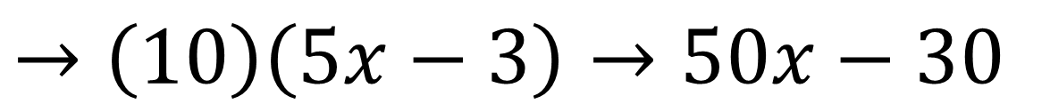
Determine $k′(x)$ if $k\left(x\right)={(5x−3)}^{2}$
Solution:
Method #2:
Use the power of a function rule, which is a form of the chain rule.
${(5x−3)}^{2} →2\left(5x−3\right)→2(5x−3)(5)$
$→\left(10\right)\left(5x−3\right)→50x−30$

Slide 36

Determine $k′(x)$ if $k\left(x\right)={(5x−3)}^{2}$
Solution:
Method #2:
$k^{′}\left(x\right)=2\left(5x−3\right)\left(5\right)=10\left(5x−3\right)=50x−30$

Slide 37

Example
Determine $k′(x)$ if $k\left(x\right)={−3(15x^{4}+8x^{3}−3x+1)}^{6}$

Slide 38


Determine $k′(x)$ if $k\left(x\right)={−3(15x^{4}+8x^{3}−3x+1)}^{6}$
Solution:
$k^{′}\left(x\right)=−18{\left(15x^{4}+8x^{3}−3x+1\right)}^{5}\left(60x^{3}+24x^{2}−3\right)$

Slide 39

Example
Determine the equation of the line tangent to the curve
$y=x^{3}+2x^{2}−4x+1$ at $x=4$.

Slide 40
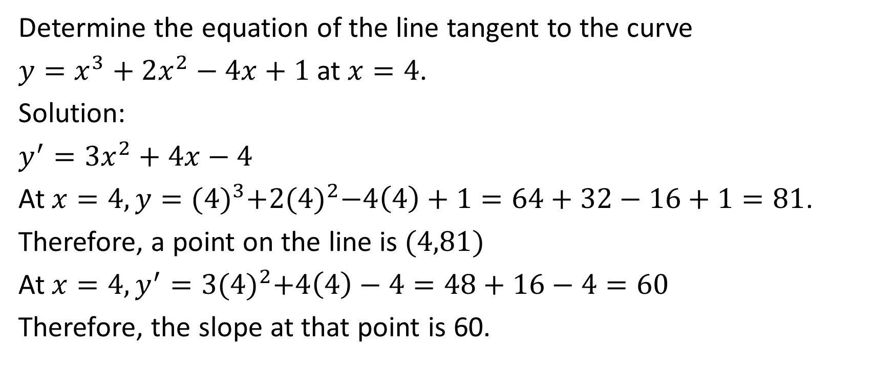
Determine the equation of the line tangent to the curve
$y=x^{3}+2x^{2}−4x+1$ at $x=4$.
Solution:
$y^{′}=3x^{2}+4x−4$
At $x=4, y={(4)}^{3}+2{(4)}^{2}−4\left(4\right)+1=64+32−16+1=81$.
Therefore, a point on the line is $(4,81)$
At $x=4,y^{′}=3{(4)}^{2}+4\left(4\right)−4=48+16−4=60$
Therefore, the slope at that point is 60.

Slide 41
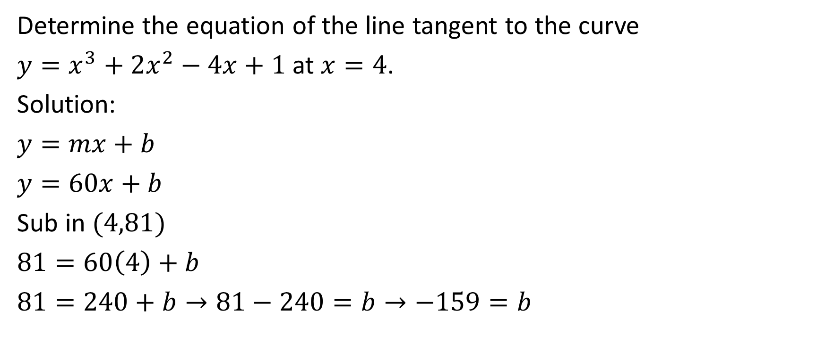
Determine the equation of the line tangent to the curve
$y=x^{3}+2x^{2}−4x+1$ at $x=4$.
Solution:
$y=mx+b$
$y=60x+b$
Sub in $(4,81)$
$81=60\left(4\right)+b$
$81=240+b→81−240=b→−159=b$

Slide 42
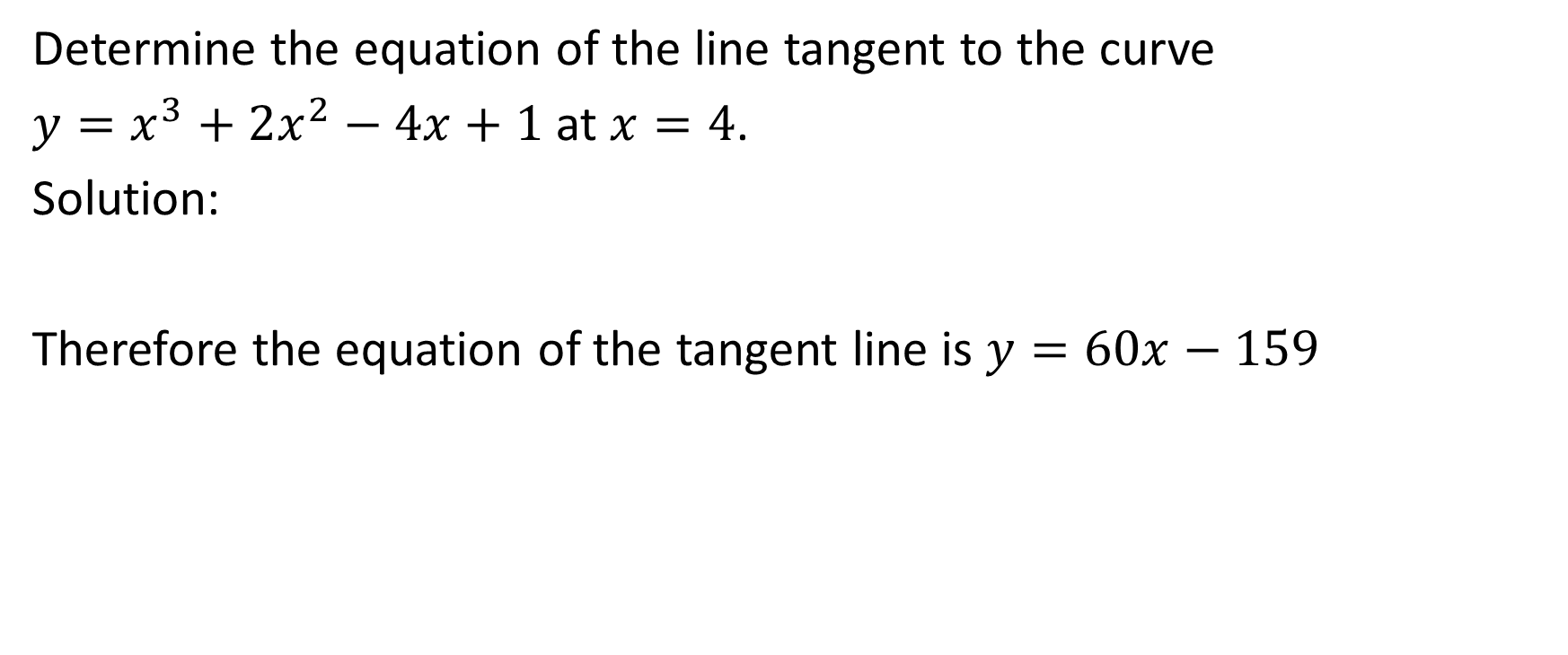
Determine the equation of the line tangent to the curve
$y=x^{3}+2x^{2}−4x+1$ at $x=4$.
Solution:
Therefore the equation of the tangent line is $y=60x−159$

Slide 43

Example
Determine the points on the curve $y=x^{3}+2x^{2}−4x+1$ where the tangent lines are horizontal.

Slide 44
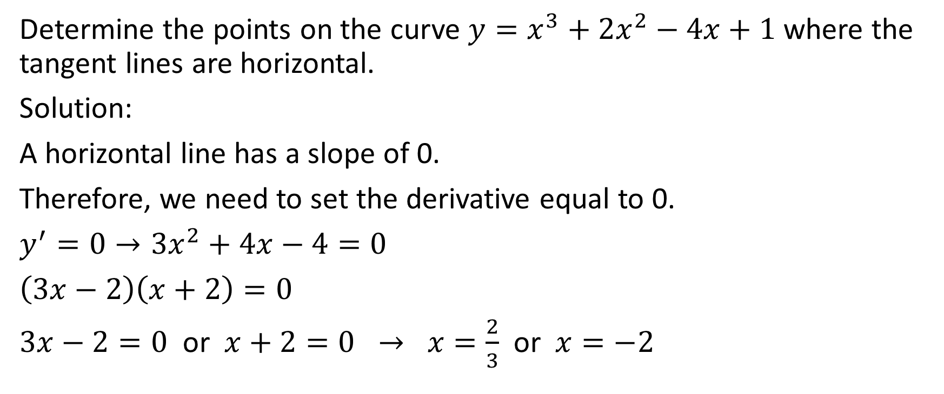
Determine the points on the curve $y=x^{3}+2x^{2}−4x+1$ where the tangent lines are horizontal.
Solution:
A horizontal line has a slope of 0.
Therefore, we need to set the derivative equal to 0.
$y^{′}=0→3x^{2}+4x−4=0$
$\left(3x−2\right)\left(x+2\right)=0$
$3x−2=0$ or $x+2=0 → x=\frac{2}{3}$ or $x=−2$

Slide 45
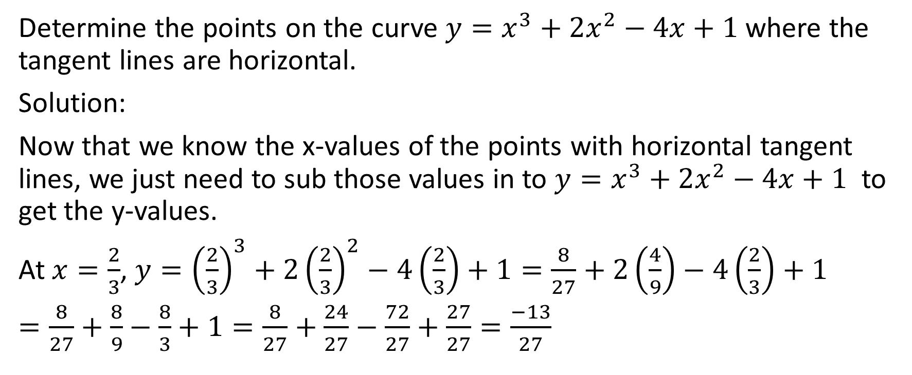
Determine the points on the curve $y=x^{3}+2x^{2}−4x+1$ where the tangent lines are horizontal.
Solution:
Now that we know the x-values of the points with horizontal tangent lines, we just need to sub those values in to $y=x^{3}+2x^{2}−4x+1$ to get the y-values.
At $x=\frac{2}{3}$, $y={\left(\frac{2}{3}\right)}^{3}+2{\left(\frac{2}{3}\right)}^{2}−4\left(\frac{2}{3}\right)+1=\frac{8}{27}+2\left(\frac{4}{9}\right)−4\left(\frac{2}{3}\right)+1$
$=\frac{8}{27}+\frac{8}{9}−\frac{8}{3}+1=\frac{8}{27}+\frac{24}{27}−\frac{72}{27}+\frac{27}{27}=\frac{−13}{27}$

Slide 46
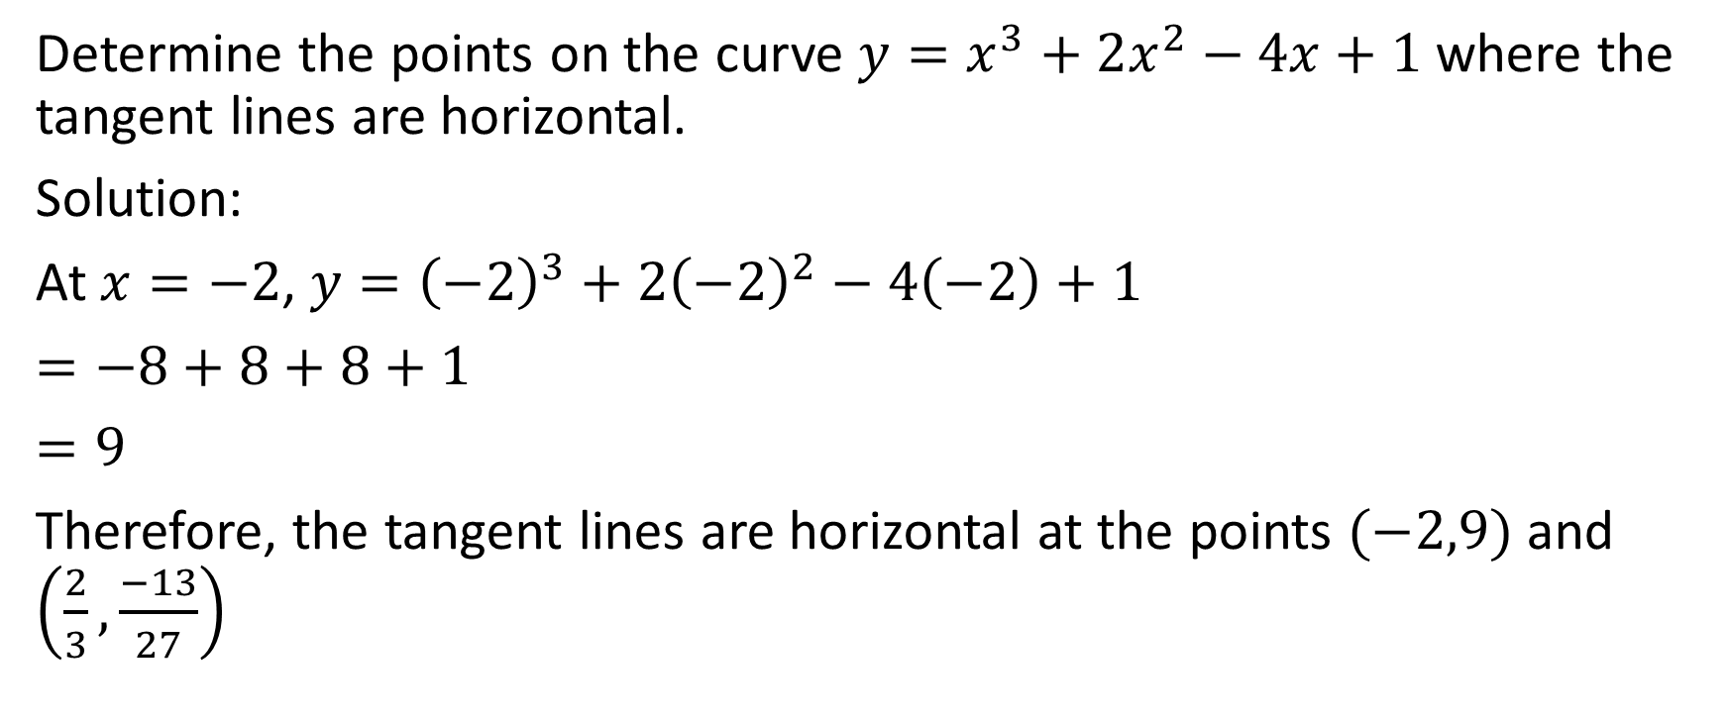
Determine the points on the curve $y=x^{3}+2x^{2}−4x+1$ where the tangent lines are horizontal.
Solution:
At $x=−2$, $y={\left(−2\right)}^{3}+2{\left(−2\right)}^{2}−4\left(−2\right)+1$
$=−8+8+8+1$
$=9$
Therefore, the tangent lines are horizontal at the points $(−2,9)$ and $\left(\frac{2}{3},\frac{−13}{27}\right)$

